Slide 1
MCmatlab
Dev Bhatia
Boston University
Ultrafast Optics Laboratory

Slide 2
Components of MCmatlab
MCmatlab is a codebase designed to do two things ~
Rapid solving of three-dimensional Monte Carlo, Radiative Transfer Equations
Simulations of finite-element heat diffusion and Arrhenius-based thermal tissue damage
Our focus is placed on the latter

Slide 3
Heat Deposition, Diffusion, Thermal Damage
As stated before, MCmatlab includes a 3-dimensional time-domain heat deposition and diffusion solver
Operates on a voxel grid
Arrhenhius-based thermal chemical changes (tissue coagulation) are calculated
Temperature distribution is based on the fluence rate and the geometry definition of the MC simulation
Also considers specific physical thermal properties of the media

Slide 4
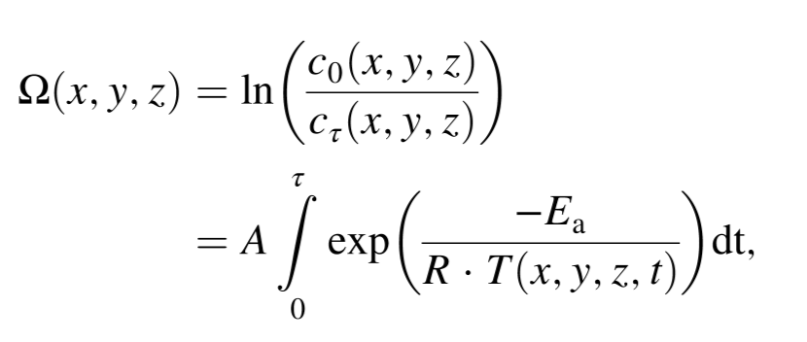
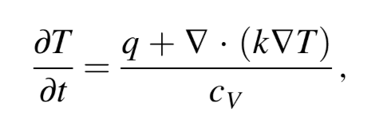
∆T Calculation
Active variables ~
q = local rate of heat deposition
Cv = local volumetric heat capacity
k = thermal conductivity
Ea = Arrhenius activation energy
A = Arrhenius pre-exponential factor
c0 = concentration of undamaged voxels (start)
ct = concentration of undamaged voxels (end)
R = gas constant
τ = total simulated time duration
Eqn. 1 – Heat eqn in continuous form
Eqn. 2 – Thermal chemical change per voxel in terms of the Arrhenius value

Slide 5
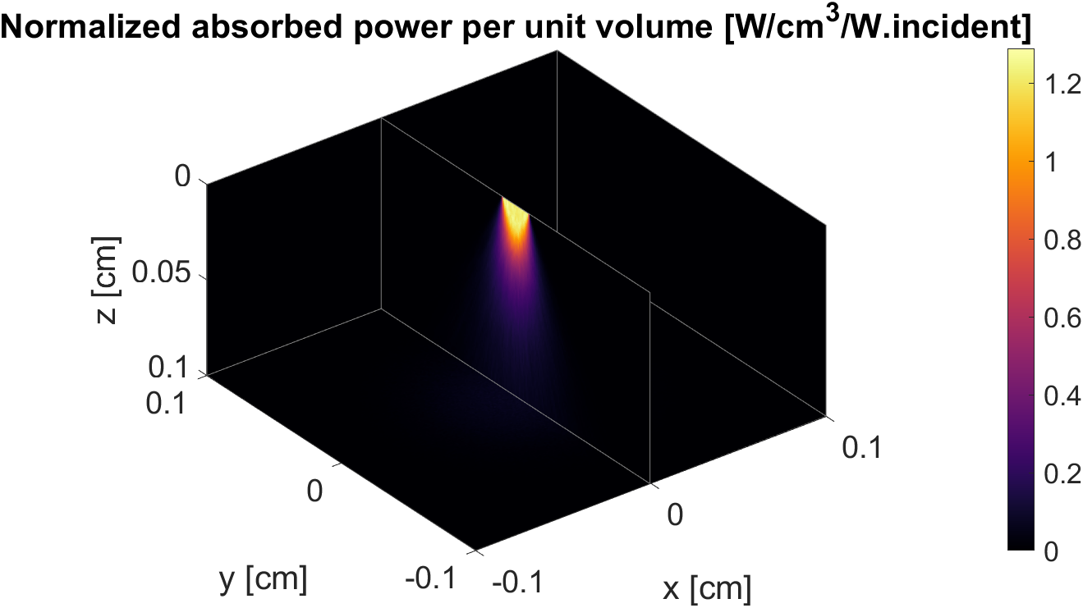
Testing the Simulation
Fig. 1 – Sample Gaussian Beam through Water
Notes:
Gaussian Beam in Water

Slide 6
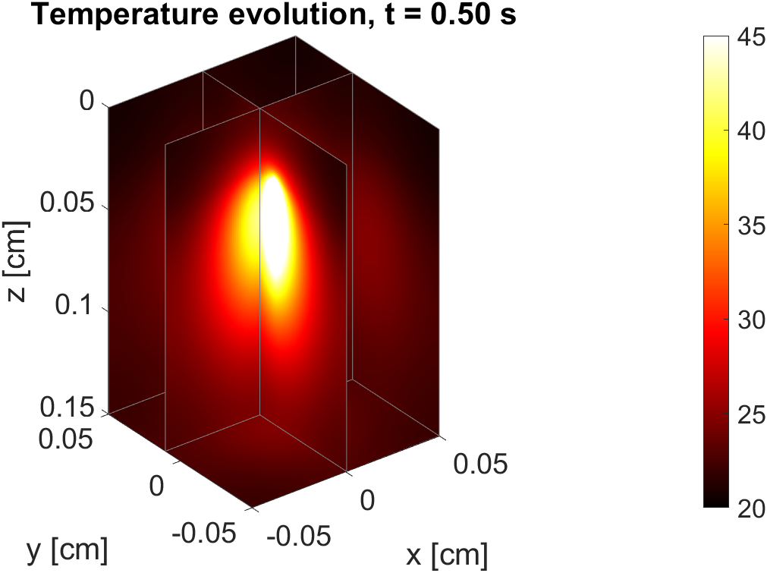
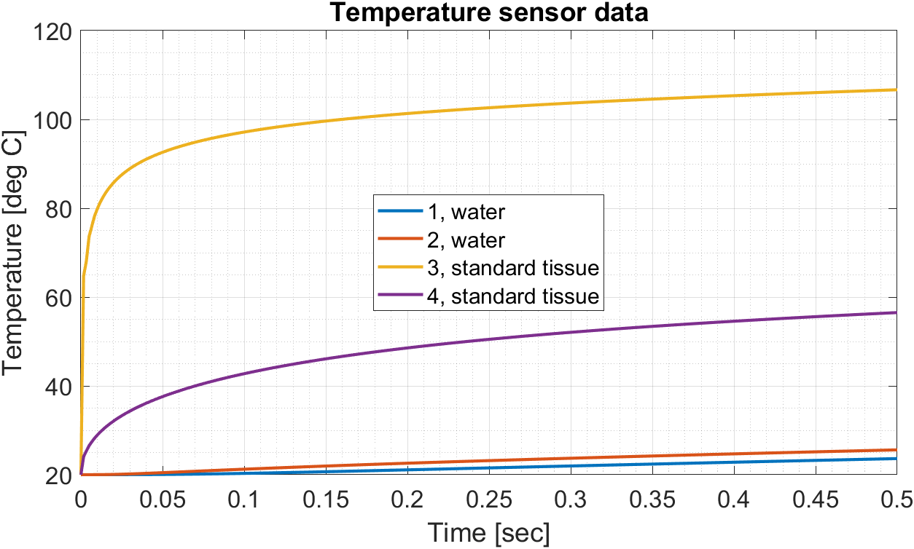
Simple Tissue
Fig. 2 – Simple Tissue 3-dimensional temperature depiction
Fig. 3 – Selected temperature sensor data
Notes:
Gaussian Beam against simple tissue

Slide 7
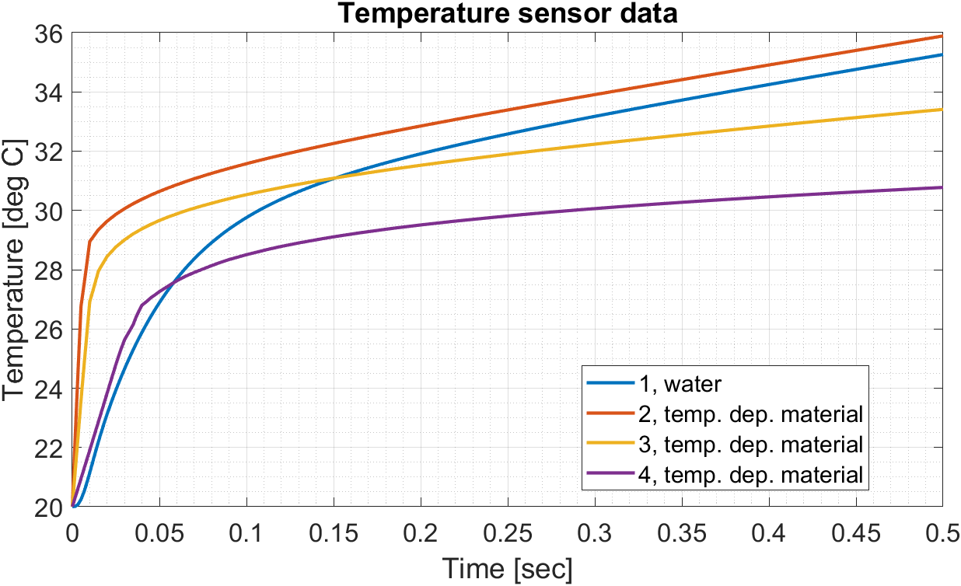
Temperature Dependent Media
Fig. 4 – Temperature Dependent Media using VHC, implanting target parameters
Notes:
Temp dependent VHC

Slide 8
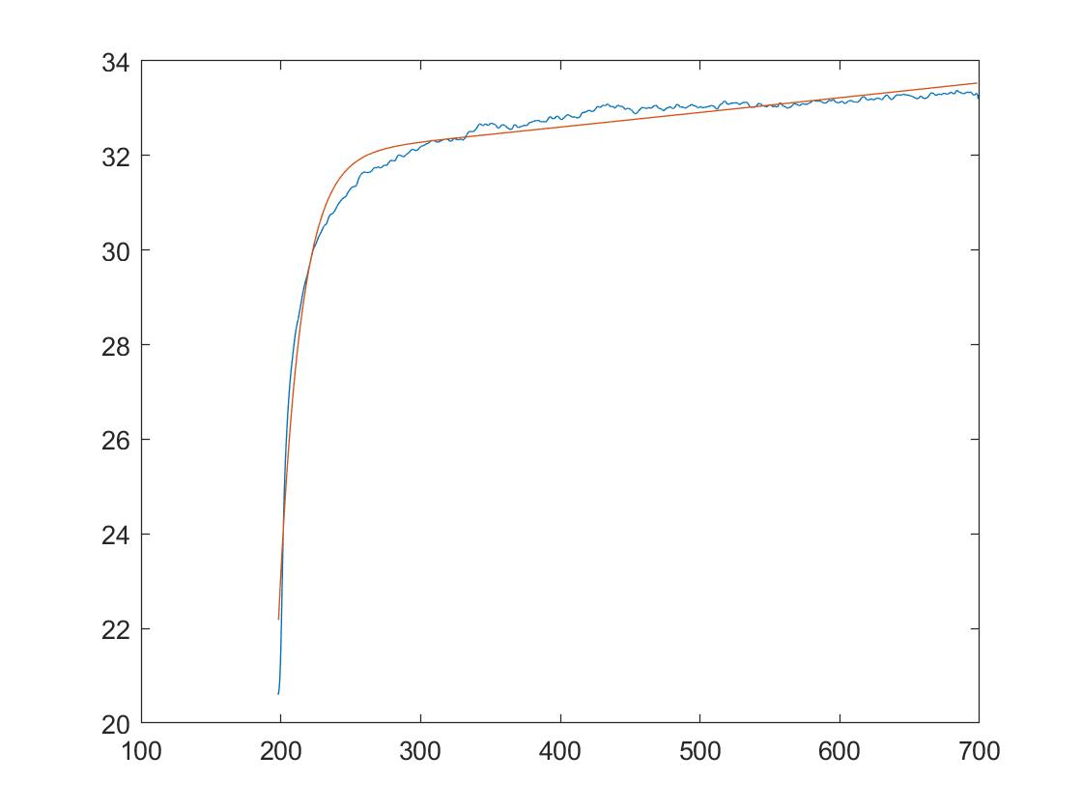
Comparison to Experimental Data
Experimental Data
Temperature (deg C)
Time (ms)
Fig. 4 – Temperature Dependent Media using VHC, implanting target parameters
Fig. 5 – Experimental Data, plotted using Matlab
Notes:
Comparison to experimental data

Slide 9
Conclusion
Mcmatlab can be tailored towards our experimental data, while introducing new degrees of precision
The software is very open-ended, such that the use cases could be very broad
More exploration of the extent of these modifications will be completed
Notes:
Conclusion

Slide 10
References
Marti, Dominik, Aasbjerg, Rikke N, Andersen, Peter E, & Hansen, Anders K. (2018). MCmatlab: an open-source, user-friendly, MATLAB-integrated three-dimensional Monte Carlo light transport solver with heat diffusion and tissue damage. Journal of Biomedical Optics, 23(12), 1–6. https://doi.org/10.1117/1.JBO.23.12.121622
Zhu, Xuedong, Jen-Wei Lin, and Michelle Y Sander. "Infrared Inhibition and Waveform Modulation of Action Potentials in the Crayfish Motor Axon." Biomedical Optics Express 10, no. 12 (2019): 6580-6594.
Notes:
Sources

